Slide 1
what is critical thinking

Slide 2

Slide 1: Understanding Critical Thinking
Critical thinking is the ability to analyze, evaluate, and interpret information objectively and make informed decisions. It involves questioning assumptions, recognizing biases, and considering different perspectives. Critical thinkers are open-minded, curious, and willing to explore new ideas and viewpoints.

Slide 3
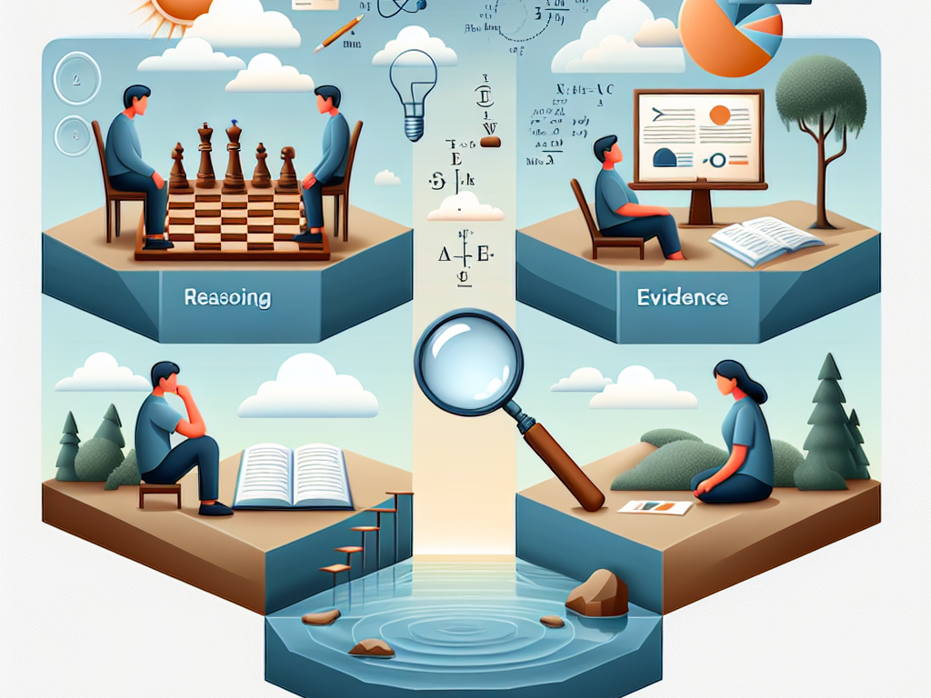
Slide 2: Key Components of Critical Thinking
Key components of critical thinking include reasoning, logic, evidence, and reflection. Critical thinkers use logic to identify and analyze arguments, evaluate evidence to support claims, and reflect on their own thought processes. They seek to understand the underlying assumptions and implications of information.

Slide 4
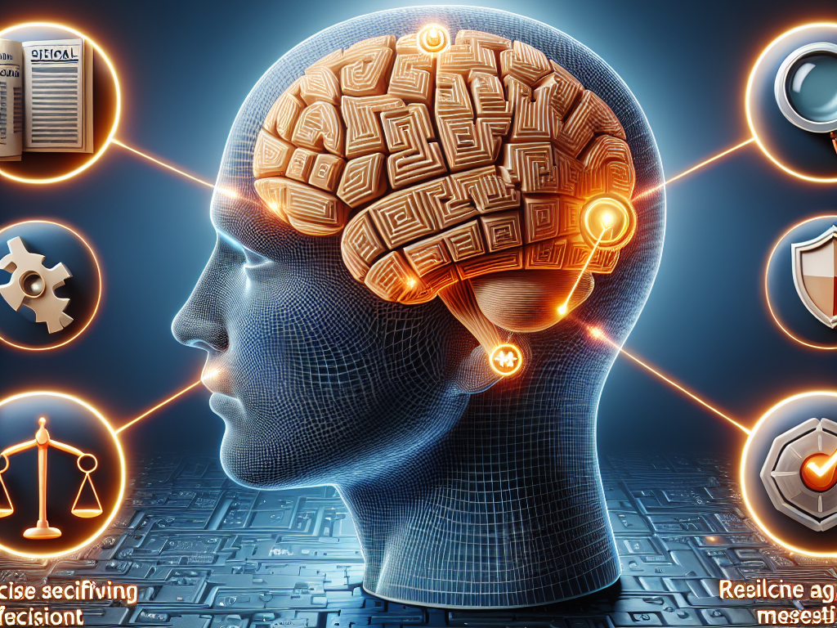
Slide 3: Importance of Critical Thinking
Critical thinking is essential for problem-solving, decision-making, and effective communication. It helps individuals navigate complex situations, identify reliable sources of information, and avoid falling prey to misinformation. In today's fast-paced world, critical thinking skills are crucial for success in both personal and professional endeavors.

